Slide 1
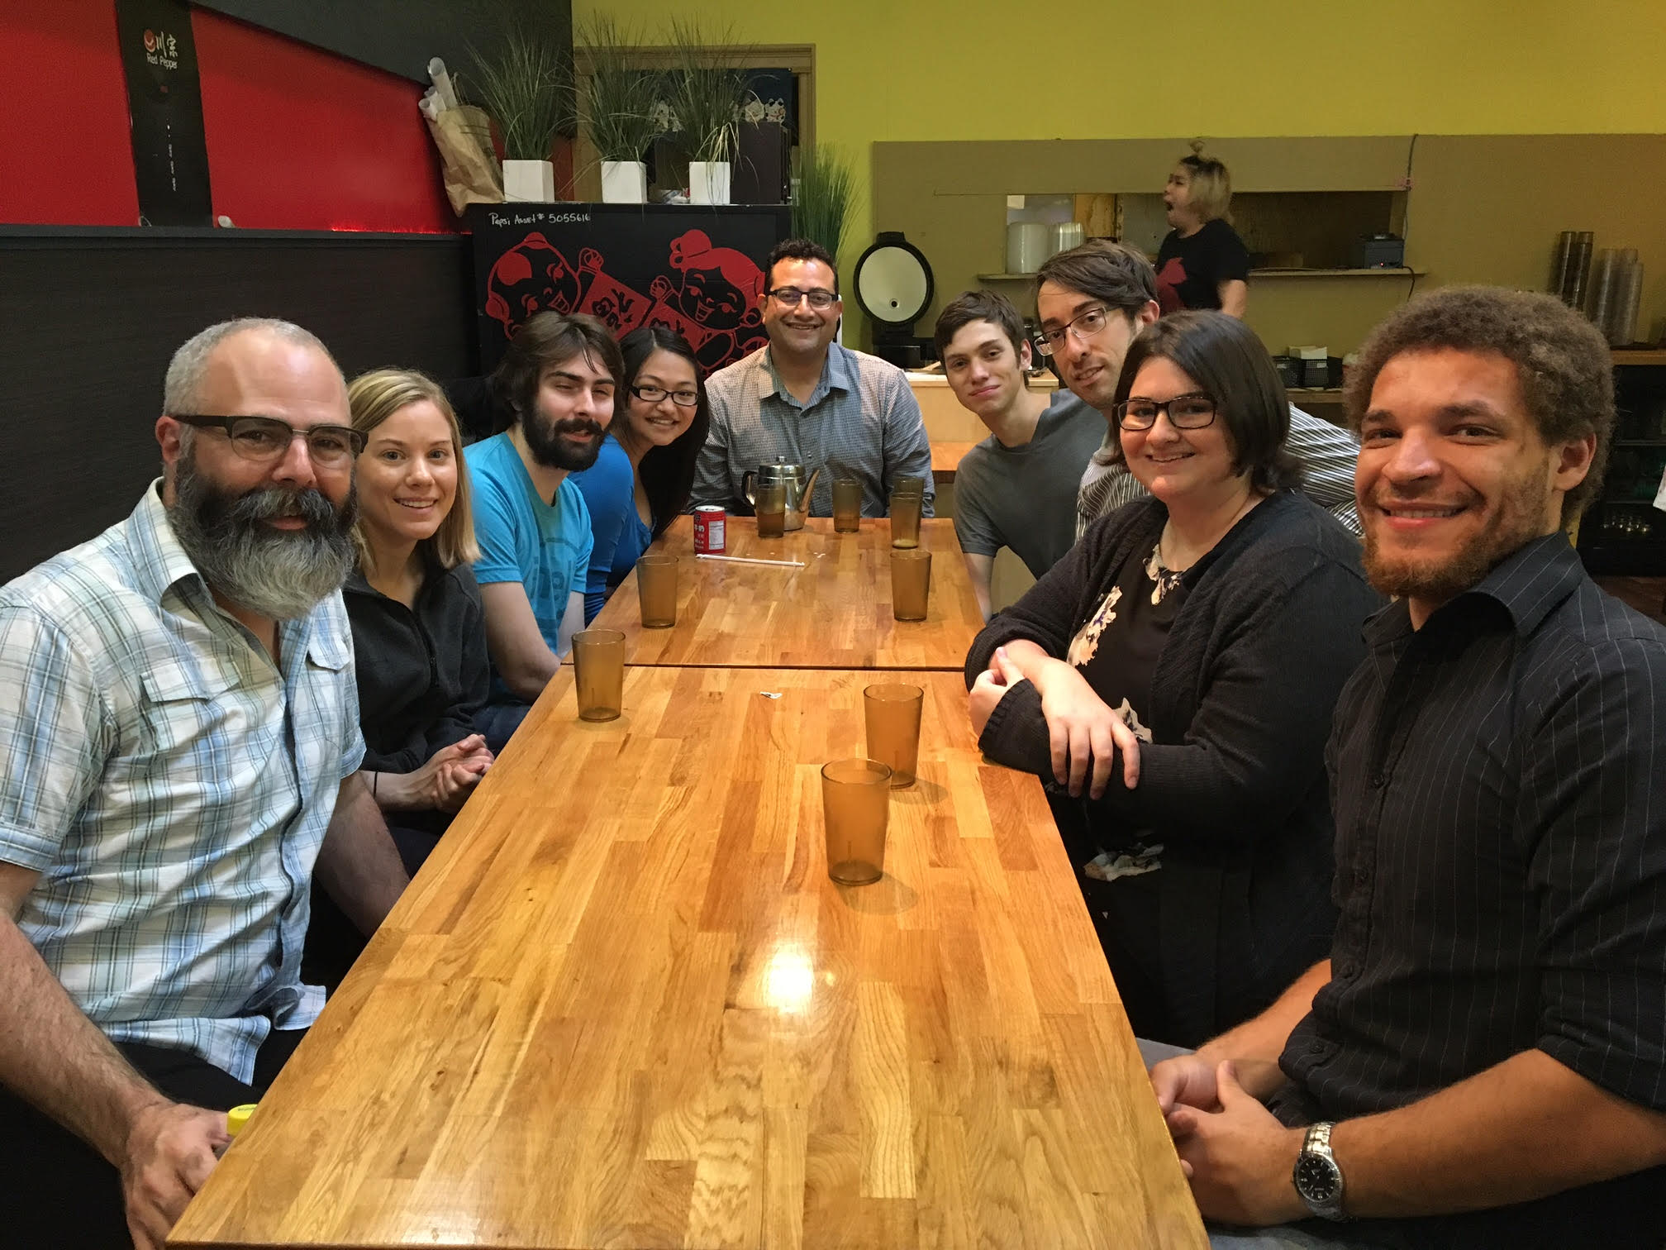
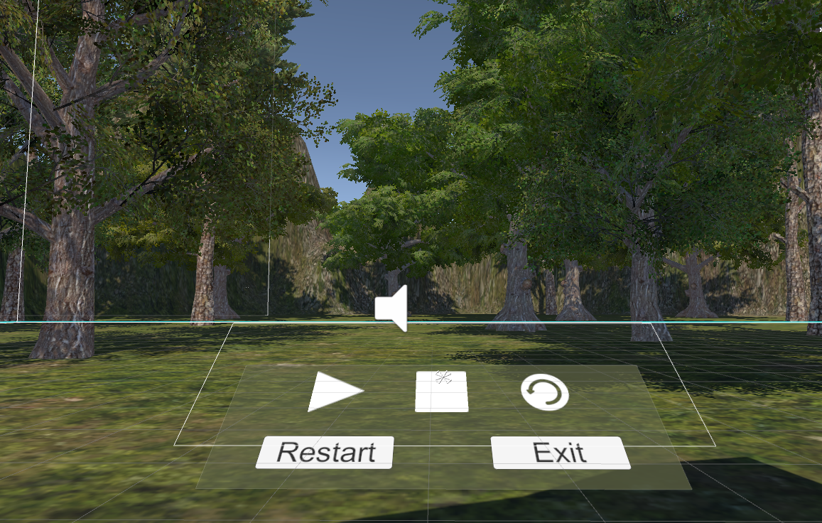
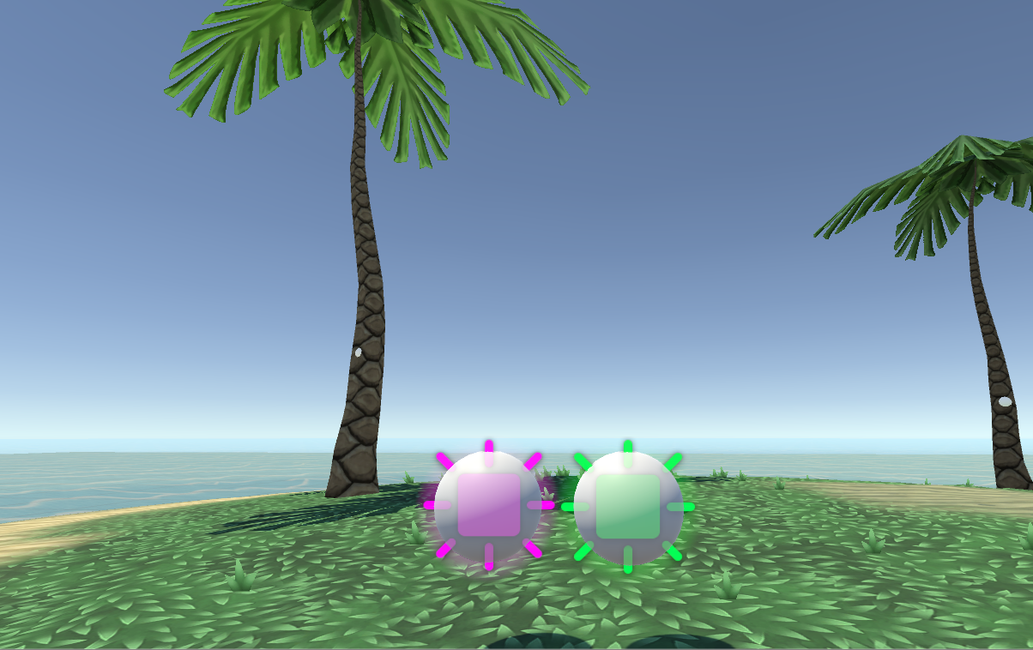
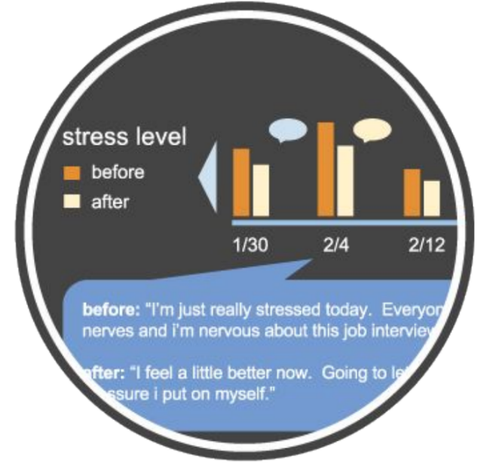
Meditation in virtual Reality
Asking the Right Question
Meet The Team!
The Plan
After our team constructed an initial proof of concept build, it was clear that this project was turning into a passion project for everyone involved. Our Intel stakeholders eagerly worked with us to chalk up a plan for how different scenes, each with a distinct personality, could help the end user feel at ease.
Let’s Do Research
To make an effective product, our stakeholders at Intel knew that there needed to be research conducted to better understand who our target audience is and how we can better serve them. Our stakeholders enlisted the help of Calm Cats, a Human Centered Design & Engineering masters capstone team to help answer an important design question. With their help, our team was able to create effective prototypes to test our collective design question.
The Design Question
How might we enable a stressed user to effectively take control of their mind and anxiety with meditation practices in virtual reality?
A Journey In Helping You Relax.
Active Prototypes:
Rapid Forest Prototype
The initial proof of concept build.
Has had multiple functionality changes.
Currently, small aspects of the environment change based on a 40 second or 80 second meditation audio clip.
Concentration
Influenced by participants of the UX studies.
Used to test if concentrating on a task within VR is as relaxing as meditation within VR.
Participants follow prerecorded patterns of one or two orbs using the HTC Vive controllers.
Key Figures
Oregon State Capstone Team
Padraig Gillen
Makiah Merritt
Erik Watterson
Intel Stakeholders
Mike Premi, Project Sponsor
Marissa Powers, Project Lead
Lindsay Benjamin, Meditation Expert
Calm Cats Masters team of the University of Washington Human Centered Design & Engineering, Feasibility Study
Kira Cassels
Ryan Moore
Ricki Mudd
Paul Townsend
Partnering with the Key figures listed above, this collaboration was able to explore the feasibility of Meditation within the emerging virtual reality space. Using the HTC Vive and Unity, our capstone group developed a variety of prototypes, or experiences, requested by Marissa Powers and the Masters team, Calm Cats. With these prototypes Calm Cats was able to perform user studies to see if individuals were able to achieve a deeper level of calmness aided by an immersive experience.
Imagine...
being at work, completely frustrated with a project, and you just want to feel like you can breathe again. Meditation in VR will help you step away from stressful environments by placing you in calming virtual atmospheres, and allowing you to ease your stress by having you concentrate on simple tasks. These tasks have been proven to reduce stress and, when continually used over time, to keep stress away.
Project Motivation
“This project will explore the newly emerging field of VR and human well-being. We have the opportunity to work with content experts in the fields of Psychology, meditation, computer science and User design to create an application that will offer the user a palate of meditative and relaxation experiences. The application will bring together the newest techniques in VR game design, and beautiful visual and audio landscapes. A myriad of Neuroscience research over the last few years has indicated the value and importance of meditation practice and this application will be designed to take the individual student on this journey inward, from within their HMD.” – Mike Premi
Testing Results
Guided Meditation experiences are commonly used and are preferred.
Health, fitness and meditation applications are often downloaded but rate of usage is low.
Of the users tested, people believed that meditation in VR could be effective.
Design Requirements
Product should help users relax.
Exercises should allow users to focus on breathing.
Afford users a way to track moods, through a mood/feeling rating and a journal option.
Gamification should be used to encourage long-term use.
The Project’s Next Steps
Use research to showcase potential of technology to execs and internal stakeholders.
Research will provide foundation for potential external developer to build out commercial grade solutions.
Identify channels to distribute this solution to a large audience to increase adoption of meditation and improve lives.
Notes:
If tri-fold mounting at SMS – make sure no text or image is in-between the two vertical guide lines; this space will be cut away. To view the vertical guide lines: Select “View” from the main menu, select “Guides” from the pull down menu, and lastly select “Static Guides”.

